Slide 1


Title of the Project: A STUDY ON LANE UTILIZATION
Presented by
M. Kanaka Mahalakshmi (18331A0159) B. Yoshita (18331A0106)
S. Chakri Pavan Kumar(18331A0114) K.N.V.S. Nikhil(18331A151)
Under the guidance of
Mr. G. Rahul Reddy, Assistant Professor
Department of Civil Engineering, MVGR College of Engineering (Autonomous)

Slide 2
Introduction
The purpose of this project is to study the traffic characteristics on lane utilization.
Lane Utilization can roughly be defined as how the rate of traffic flow is distributed among the available number of lanes in a given section.
The importance of studying lane utilization comes from the fact that it is one of the important parameters for calibrating the parameters of micro-simulation traffic models.
Traffic microsimulation models simulate the behaviour of individual vehicles within a predefined road network and are used to predict the likely impact of changes in traffic patterns resulting from changes to traffic flow or from changes to the physical environment.

Slide 3
Driving disorder, such as having difficulty in staying in the lane, abrupt lane changes and driving on the shoulder are typical consequences of many dangerous driving circumstances and can be grouped under the heading of “lateral discipline of driving”.
Recognition of these situations is largely observational and spotted/examined by police at high costs. In this project, a discrete analysis on lane utilization factor is made by observing the traffic in a time period of two hours each on peak hour.
The factors such as vehicle composition in each lane, type of vehicle travelling in each lane and sub-lanes are considered. A simple tallying is done for obtaining the volume of the traffic in individual lanes. The data is then extracted to excel sheets, bar diagrams and pie charts are fabricated for the better understanding of the study on lane utilization.

Slide 4
Literature review
Study of Lane Utilization on Delhi-Gurgoan expressway
The lane utilization is affected by several factors such as vehicle composition, traffic flow rate and vehicular speeds. In the present study, eight hours of video graphic data was collected from a road stretch on Delhi-Gurgaon Expressway, incorporating both peak and off peak hours.
The results of the present study in the form of lane utilization and lane discipline behavior by different vehicle types may help in differentiating the characteristics of traffic on expressways in relation to the other roads in India. It may be also helpful to refine the microscopic simulation models and its parameters in order to validate them at micro-level, under traffic conditions prevailing on Delhi-Gurgaon Expressway.

Slide 5
Lane-Distribution Models and Related Effects on the Capacity for a Three-Lane Freeway Section: Case Study in Italy
One of the first studies on the lane distribution for multi-lane carriageways was that by the US Public Roads Administration (Normann, 1942). In these studies, the non-homogeneous use of a multilane road was highlighted, along with the observation that the percentage of use of the shoulder lane was inversely proportional to the total flow.
With increasing flow, vehicles seemed to prefer the middle or median lanes. The first multiple regression models were proposed in these studies to fit the functional formulation of lane use percentage, known as Lane Flow Ratio (LFR).

Slide 6
Study of Speed-Flow Relationships on Individual Freeway Lanes
In this study, the relationship was examined for each of the three lanes at two locations on Highway 401 in metropolitan Toronto. It proved possible to accurately describe the mean speed in each lane with simple linear functions over the range of flows of most practical interest.
When an attempt was made to examine the relationship between speed and flow for the entire roadway, the linear functions were not adequate, but cubic functions performed reasonably well. The curves described in the manual are much steeper than the Highway 401 curves at high flows, implying a much more rapid loss of performance as flow approaches capacity than was observed.

Slide 7
Objectives
To study lane discipline and lane utilization behavior for different categories of vehicles on various national highways.
To compare the results of lane utilization factors for different lanes and vehicles observed on the road.
To model lane utilization using parameters like classified traffic volume and average stream speed for prevailing roadway and traffic conditions on the selected area of study.

Slide 8
Scope
For this purpose, two locations each in the districts of Vizianagaram and Visakhapatnam along the highways NH-16, NH-26 have been considered.
The locations taken for the study are Boyapalem(NH-16,VSP), Ghambiram(NH-16,VSP), Jonnada(NH-26,VZM), Police barracks area(NH-26,VZM).
The different vehicle categories considered for the study are car, two-wheeler, three-wheeler, heavy good vehicle (i.e. bus and trucks).

Slide 9
Broad area of work
The project falls under the category of Transportation planning, a subset of civil engineering where the modelling for multi-lane roads can be done using lane utilization factors.
The lane utilization factor, f_{LU}, is defined as the ratio of the average volume per lane to the volume in the heaviest used lane.

Slide 10
Overall Methodology
The main data collection task was to manually collect the categorical vehicular count i.e., car, two-wheeler, three-wheeler, heavy good vehicle through an instantaneous cross section of the lane in individual lanes at peak hour. The time periods for data collection were opted out such that it covers wider variation of traffic flow conditions.
For the purpose of calculating lane utilization, the lanes were classified into three distinct types (1 denoting right-shoulder side, 2 denoting right median side, 3 denoting left median side, 4 denoting left-shoulder side, 1.5 and 3.5), each representing vehicle position on the national highway from the median, hence making it possible to quantify the degree of lane-discipline followed under the prevailing basic roadway and traffic conditions.

Slide 11
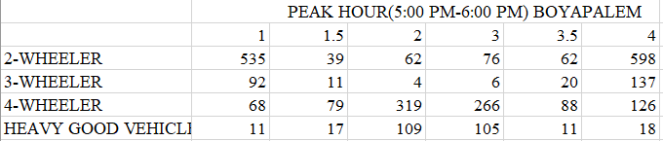
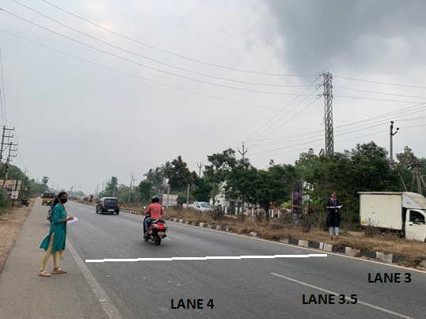
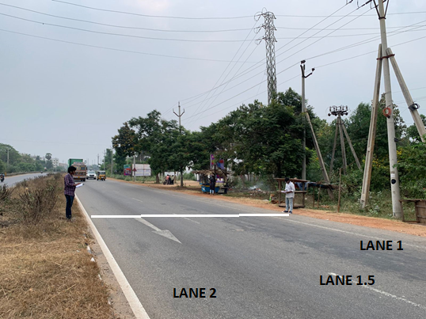
Data on lane distribution of different categories of vehicles collected on the area of work: Boyapalem

Slide 14
D – Disciplinary ND – Non-Disciplinary

Slide 15
LUF at NH16 BOYAPALEM
Lane | Total Volume | LUF
1 | 706 | 0.8
2 | 494 | 0.562
3 | 453 | 0.515
4 | 879 | 1

Slide 16
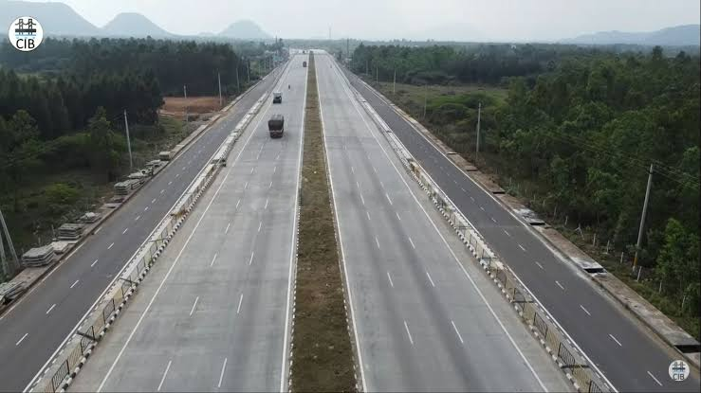
Data on lane distribution of different categories of vehicles collected on the area of work : Gambhiram
SL
1
2
3
4
5
6
SL
1.5
4.5
5.5
2.5

Slide 19
D – Disciplinary ND – Non-Disciplinary

Slide 20
LUF at Ghambiram
Lane | Total Volume | LUF
1 | 52 | 0.75
2 | 69 | 1
3 | 69 | 1
4 | 56 | 0.81
5 | 67 | 0.97
6 | 45 | 0.65

Slide 21
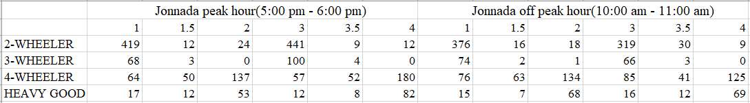
Data on lane distribution of different categories of vehicles collected on the area of work: Jonnada

Slide 24
D – Disciplinary ND – Non-Disciplinary

Slide 25
LUF at Jonnada
Lane | Total Volume | LUF
1 | 568 | 0.93
2 | 214 | 0.35
3 | 274 | 0.44
4 | 610 | 1

Slide 26
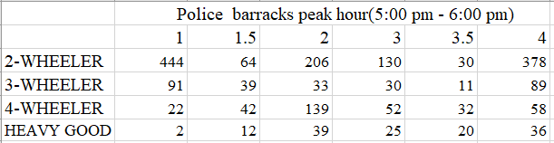
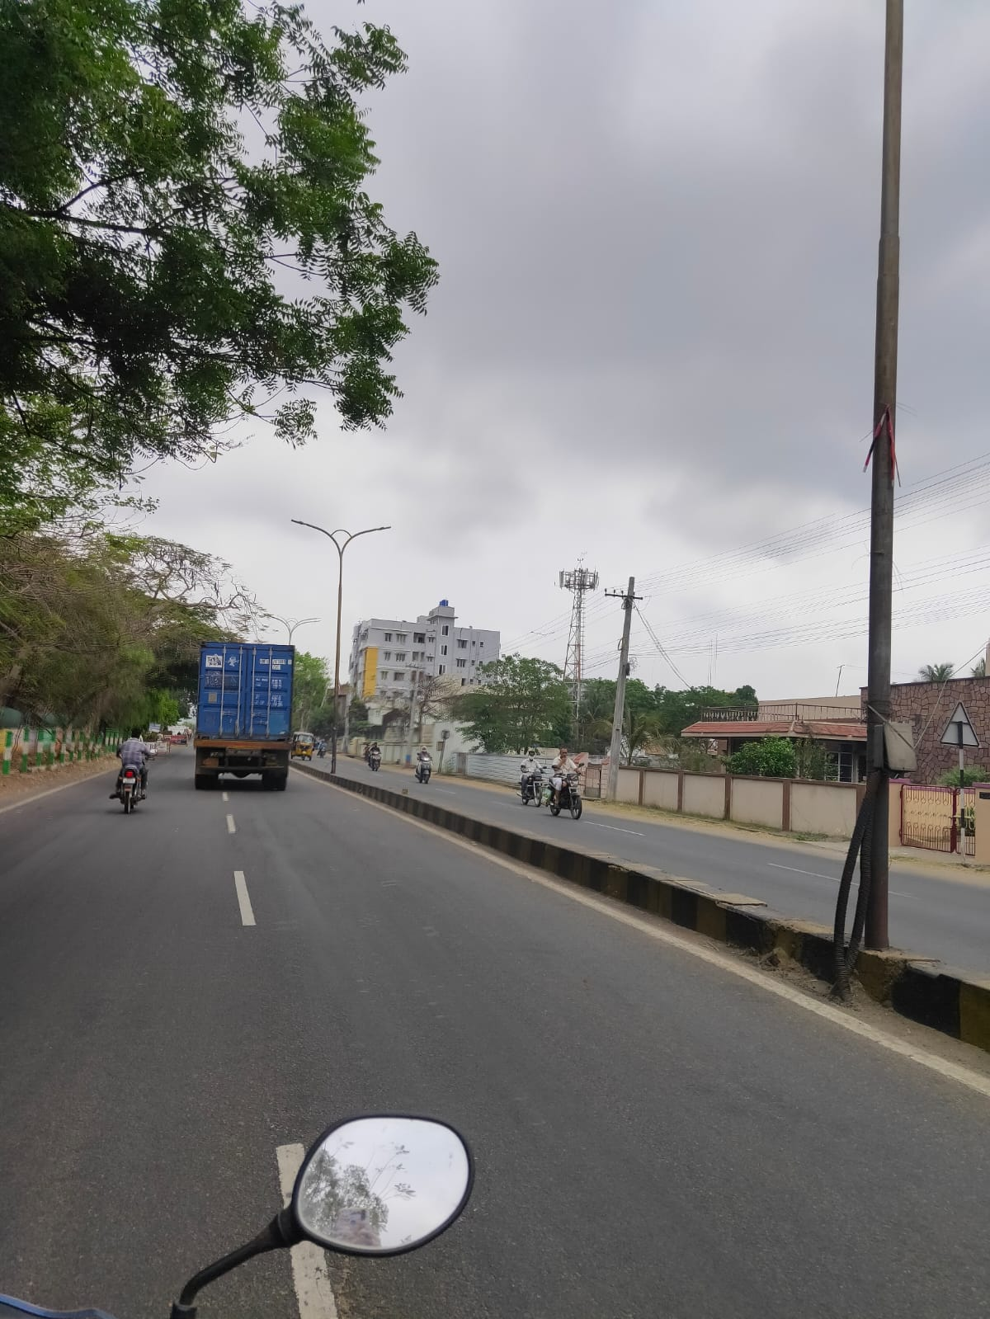
Data on lane distribution of different categories of vehicles collected on the area of work: Police barracks

Slide 29
D – Disciplinary ND – Non-Disciplinary

Slide 30
LUF at Police barracks
Lane | Total Volume | LUF
1 | 559 | 0.99
2 | 417 | 0.74
3 | 237 | 0.422
4 | 561 | 1

Slide 31
Results
The lane discipline is concerned, two-wheelers 97.1%, 78.5%, 93.7%, 65.6%, three-wheeler 84.8%,100%, 96%, 61.4%, four-wheeler 94.9%, 70%, 58.7%, 55.3%, Heavy Good Vehicles 10.7%, 7.4%, 15.7%, 28.3% at Boyapalem, Ghambiram, Jonnada, Police Barracks respectively follow the lane discipline.
The Lane Utilization Factors at Boyapalem breaks down to 0.8, 0.562, 0.515,1 and at Ghambiram 0.75, 1, 1, 0.81, 0.97, 0.65, at Jonnada the LUF is 0.93, 0.35, 0.44, 1 and at Police Barracks 0.99, 0.74, 0.422, 1 at lanes 1, 2, 3 and 4 (5 and 6 lanes at Ghambiram) respectively.

Slide 32
Conclusions
Because of smaller size, all the two-wheelers are found to follow lane-discipline. In a single designated lane, the parallel movement of two two-wheelers was observed simultaneously, which may be possible only by virtue of their smaller size.
It is observed that there are significant number of cars, three-wheelers and heavy vehicles which do not follow perfect lane-discipline.

Slide 33
Conclusions
But, this observed degree of lane based vehicle movement is relatively different as compared to the other multilane roads (National Highways, urban arterial roads, etc.) in India.
It is also found that the proportion of cars linearly decreases from median side lane to shoulder side lane i.e. from lane-1 to lane-4, whereas the proportion for two-wheelers, three-wheelers, trucks and buses linearly increases from lane-1 to lane-4.

Slide 34
Acknowledgements
We are thankful to the Dept. of Civil Engineering, MVGR College of Engineering, for giving me the opportunity to execute this project, which is an integral part of the curriculum in B. Tech program. We are thankful to my project guide Mr. G. Rahul Reddy, Assistant Professor whose encouragement, guidance and support from the initial to the final level enabled me to develop an understanding of the subject.

Slide 35
Acknowledgements
In spite of his busy work schedule, his constant encouragement and co-operative attitude gave me confidence to complete the study within the time frame. We are thankful to Dr. P. Markandeya Raju, Professor and Head of Civil Engineering Department, for all the facilities provided to successfully complete this work.

Slide 36
Thank you
Department of Civil Engineering, MVGR College of Engineering (Autonomous)

